Slide 1
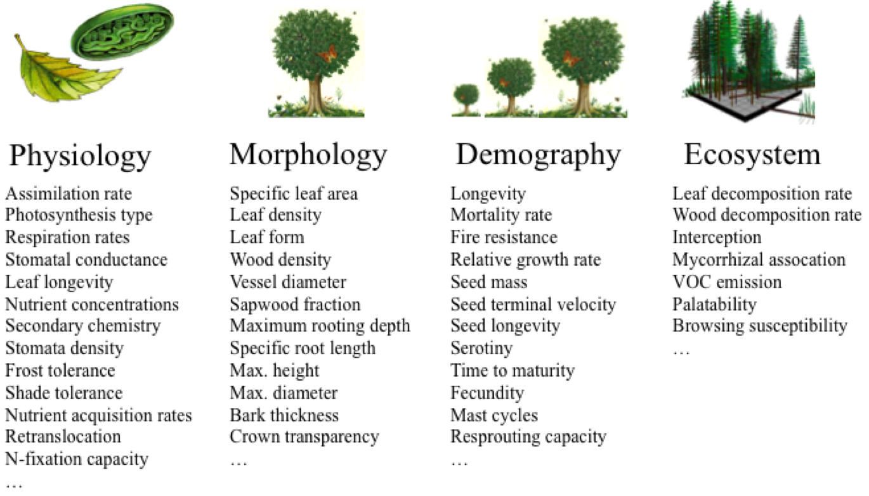
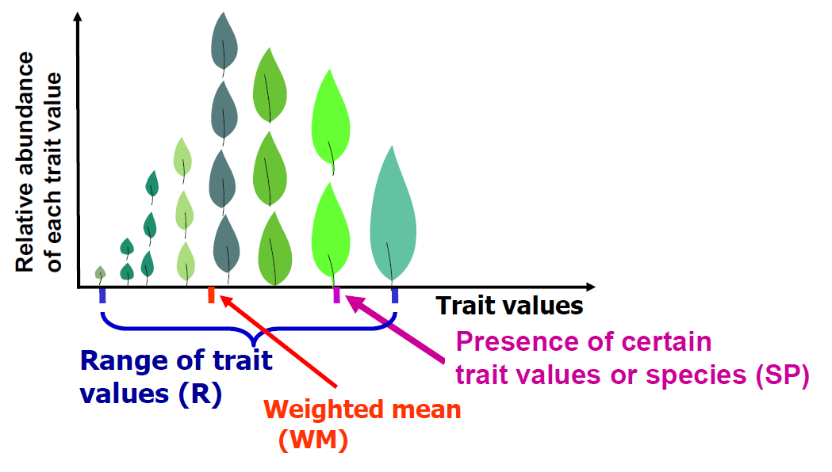
Plant Traits: „the characteristics of an organism that are considered relevant to its response to the environment and/or its effects on ecosystem functioning.”
(Díaz & Cabido 2001)
Functional trait diversity: „the value, range and relative abundance of the functional traits of the organisms present in a given ecosystem.”
(Díaz & Cabido 2001; Tilman 2001; Díaz et al. 2007)

Slide 2
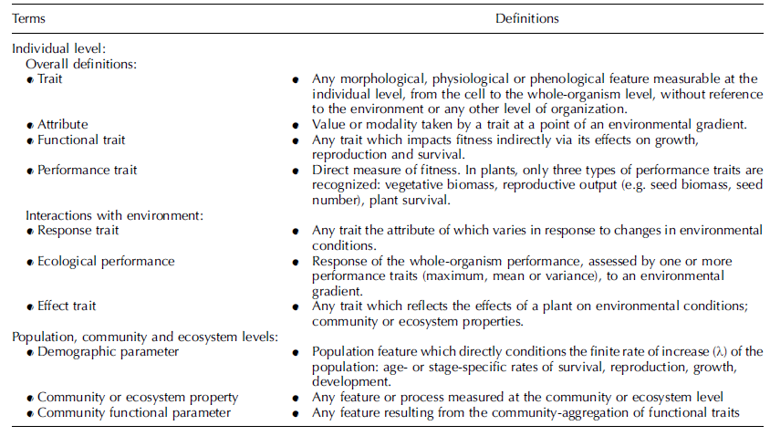
Violle et al. 2007 Oikos

Slide 5
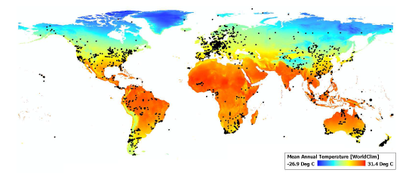
Issue No. 3
Virtually no temporal information

Slide 6
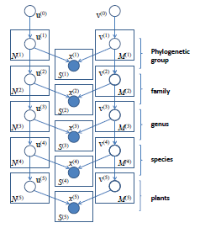
Gibbs sampler → Probability distribution
MCMC algorithm based on Metropolis algorithm

Slide 8
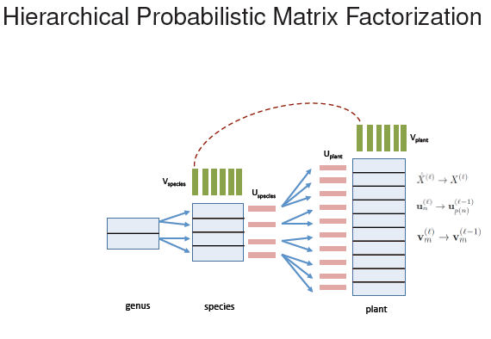

Slide 9
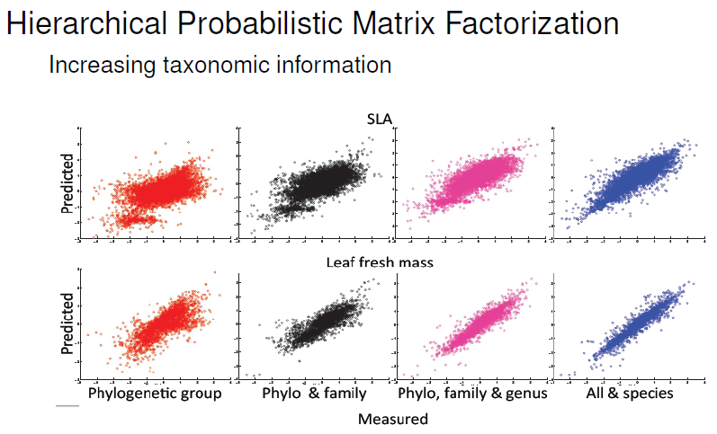
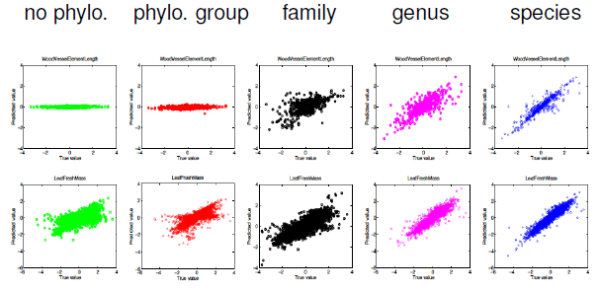

Slide 10
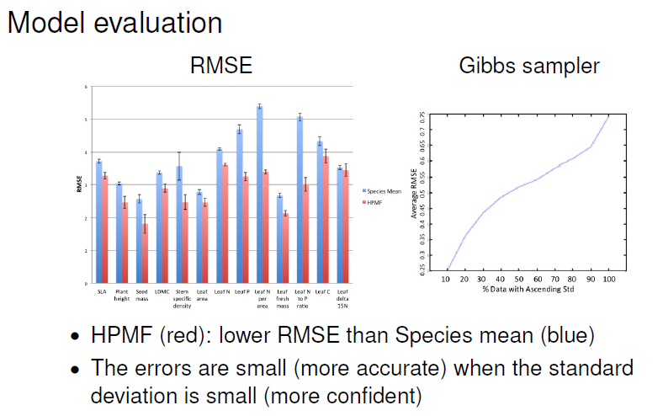

Slide 11
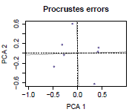
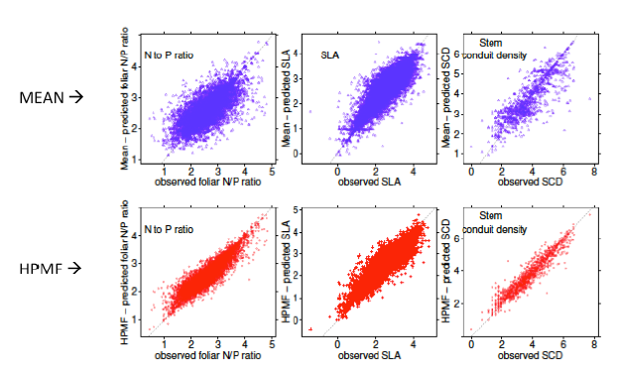

Slide 12
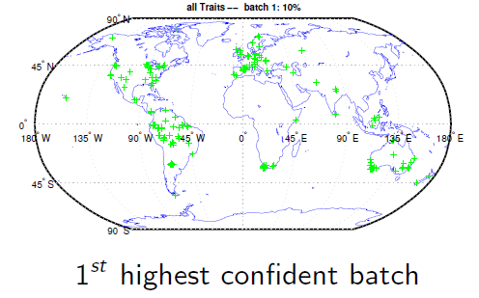
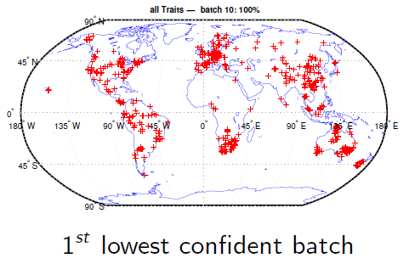

Slide 13
