Slide 1

ENVIRONMENTAL LAYERS MEETING
IPLANT TUCSON
2012-02-17
Roundup
Benoit Parmentier

Slide 2
What I have been doing so far:
Background work
Reading about the project and IPLANT.
Catching up on the processing done.
Reading about GAM and Thin Plate Spline: Wood, Hijman, Daly, etc.
Processing&Analysis
Preparing the GIS variables for the regression.
Preprocessing the station data for the Oregon case study.
Writing up a script to produce some “pilot” results.

Slide 3
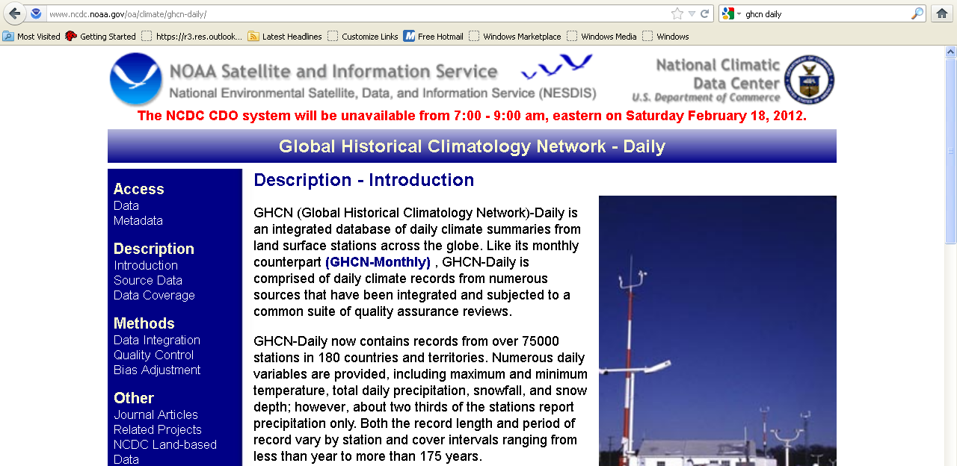
2) Processing&Analysis
->Preprocessing the station data for the Oregon case
The ghcn daily 2010 data was downloaded from NCDC and the records relevant to
Oregon and TMAX were selected.
ftp://ftp.ncdc.noaa.gov/pub/data/ghcn/daily/

Slide 4
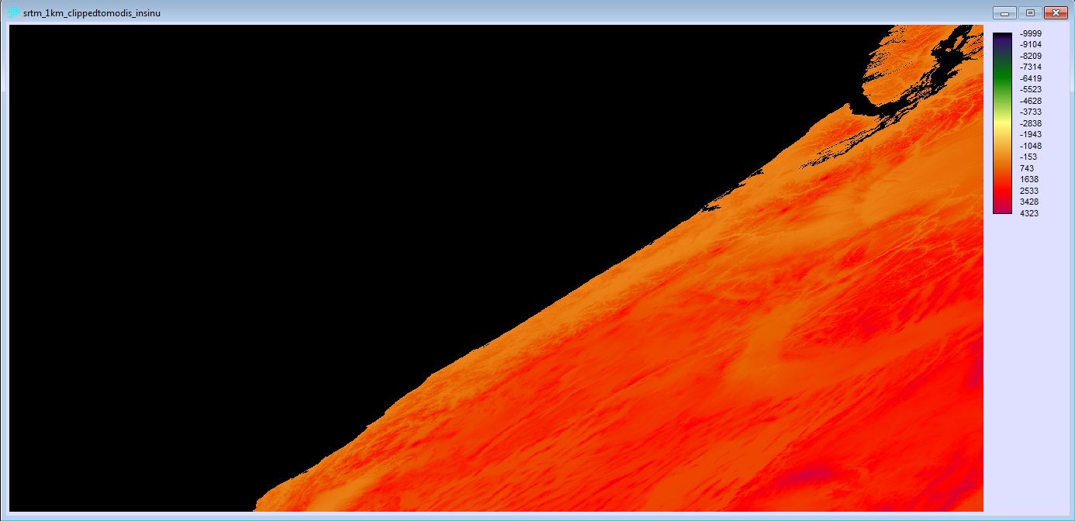
SRTM DATA
SRTM DATA CLIPPED IN MODIS SINUSOIDAL PROJECTION

Slide 5
SRTM DATA
This is the SRTM data projected in Lambert Conformal.
srtm_1km_ClippedTo_OR83M.rst
Notes:
orcnty24_OR83M.vct
ghcn_or_tmax_b_02082012_OR83M

Slide 6
PRODUCTION OF DISTANCE TO OCEAN LAYER
reclass
Land Cover Layer 10
group
reclass
Distance
Distance to ocean
Notes:
The land cover layer 10 was used to select areas related to the ocean. This was done through a sequence of GIS Operation (reclass, group and distance): W_Layer10_ClippedTo_OR83M_GROUPSEA.rst

Slide 7
PRODUCTION OF THE VARIABLE ASPECT
Notes:
The land cover layer 10 was used to select areas related to the ocean. This was done through a sequence of GIS Operation (reclass, group and distance).

Slide 8
PRODUCTION OF DISTANCE TO OCEAN LAYER
There were 14 relevant layers used for the regression:
ELEVATION: W_SRTM_1KM_CLIPPEDTO_OR83M.rst
ASPECT : W_SRTM_1KM_CLIPPEDTO_OR83M_ASPECT.rst
LC1 : W_Layer1_ClippedTo_OR83M.rst
LC2 : W_Layer2_ClippedTo_OR83M.rst
LC3 : W_Layer3_ClippedTo_OR83M.rst
LC4 : W_Layer4_ClippedTo_OR83M.rst
LC5 : W_Layer5_ClippedTo_OR83M.rst
LC6 : W_Layer6_ClippedTo_OR83M.rst
LC7 : W_Layer7_ClippedTo_OR83M.rst
LC8 : W_Layer8_ClippedTo_OR83M.rst
LC9 : LCW_Layer9_ClippedTo_OR83M.rst
LC10 : W_Layer10_ClippedTo_OR83M.rst
DISTOC :W_Layer10_ClippedTo_OR83M_GROUPSEAD_DIST.rst
CANHEIGHT :W_GlobalCanopy_ClippedTo_OR83M.rst
Variables for the regression.
Notes:
The land cover layer 10 was used to select areas related to the ocean. This was done through a sequence of GIS Operation (reclass, group and distance).

Slide 9
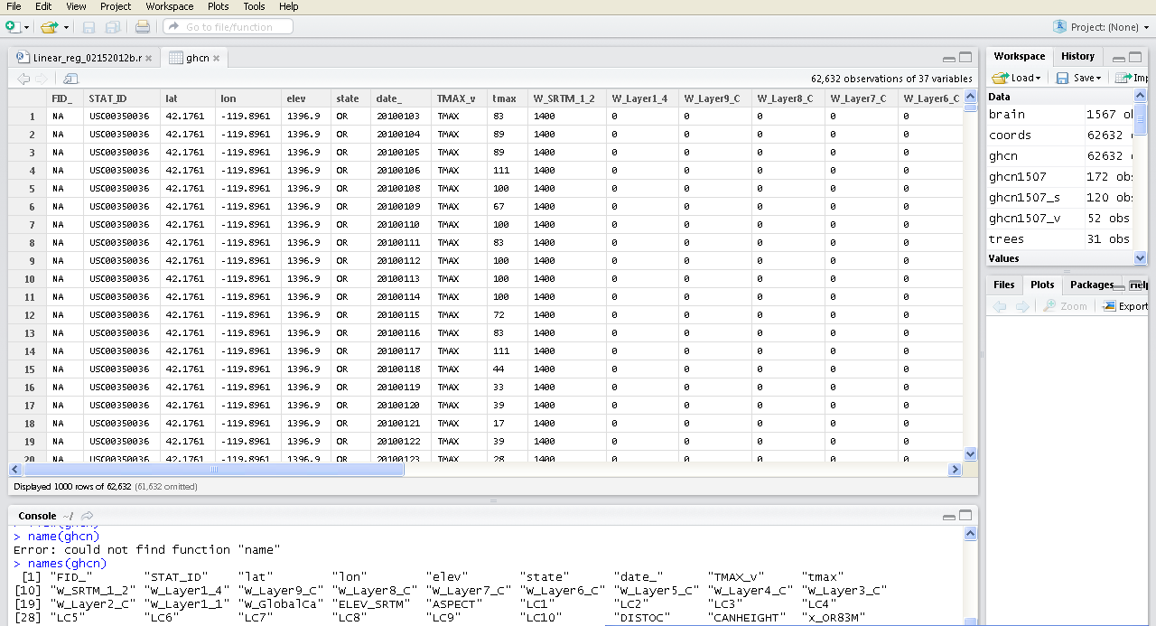
2) Processing&Analysis
-Preprocessing the station data for the Oregon case
Relevant variables were extracted to produce a small dataset for the regression…
This the dataset loaded in R-studio.

Slide 10
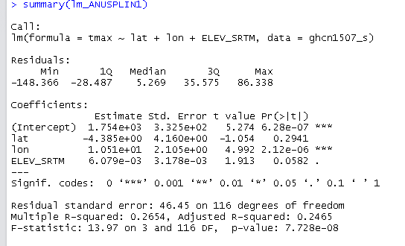
>
2) Processing&Analysis
ANUSPLIN LIKE MODEL:
REGRESSION 1: LINEAR REGRESSION

Slide 11
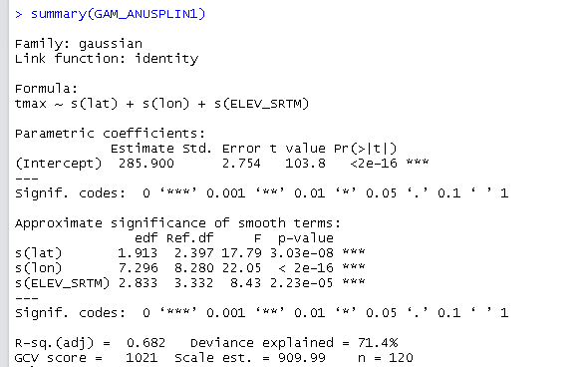
>
2) Processing&Analysis -ANUSPLIN LIKE MODEL
REGRESSION 1: GAM REGRESSION

Slide 12
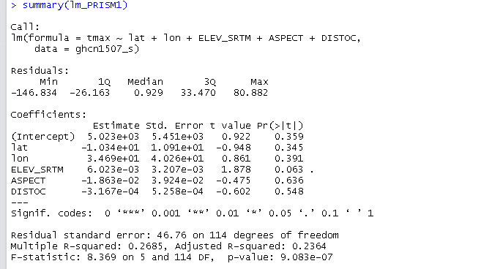
2) Processing&Analysis-PRISM LIKE MODEL
REGRESSION 2: LINEAR REGRESSION

Slide 13
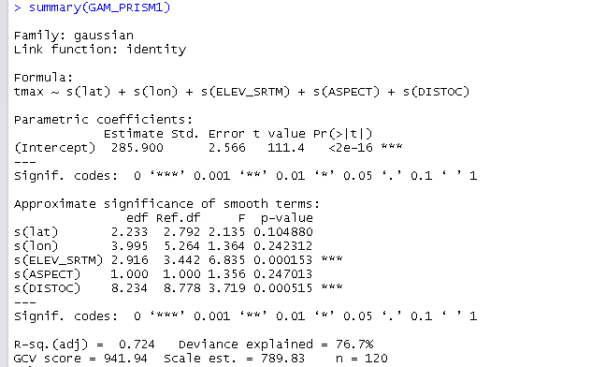
2) Processing&Analysis-PRISM LIKE MODEL
REGRESSION 2: GAM REGRESSION
Data frame excerpt or table from QGIS

Slide 14
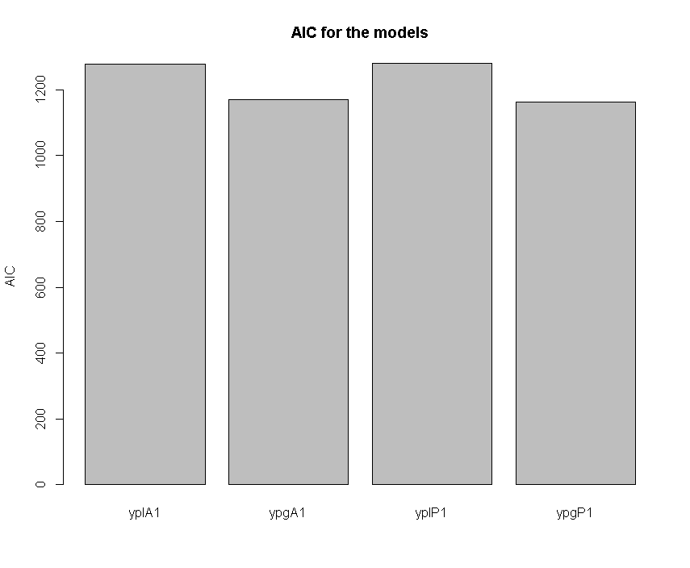
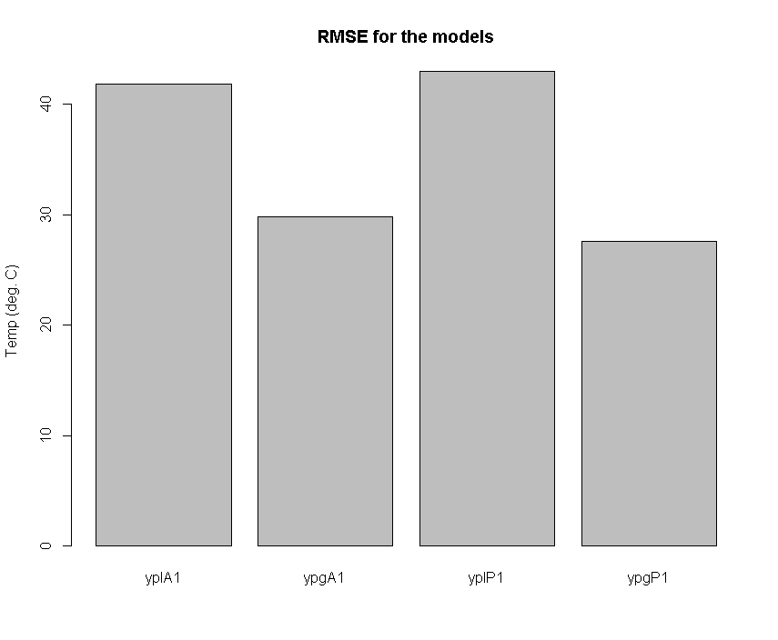
2) Processing&Analysis- BASIC MODEL COMPARISON
REGRESSION COMPARISON
 | model | RMSE | df | AIC
1 | yplA1 | 41.8162 | 5 | 1278.903
2 | ypgA1 | 29.78011 | 16.17569 | 1169.236
3 | yplP1 | 42.93981 | 7 | 1280.067
4 | ypgP1 | 27.61978 | 20.40442 | 1163.259
The RMSE validation is done on 30% of the original dataset.

Slide 15
Climate
ANUSPLIN: Tmax=f(lat,lon,elev)+ε
PRISM: Tmax=f(lat,lon,elev,inversion,marinedistance, aspect)+ε
Us: Tmax=f(lat,lon,elev,marinedistance, aspect, LST*Tree Height*land cover, cloud)+ε
Us: Precip=f(lat,lon,elev,marinedistance, aspect, TRMM,Soil Moisture SMOS, Cloud – prevailing wind*distance from ocean*rainshadow)+ε
Tmax, Tmin, Precip, (Snow depth?)
Fit f using:
  GAM with thin-plate spline
  GWR
  Thin-plate spline
  Co-Kriging
  OLS
  Neural net
Validate w/ & w/o satellite data

