Slide 1
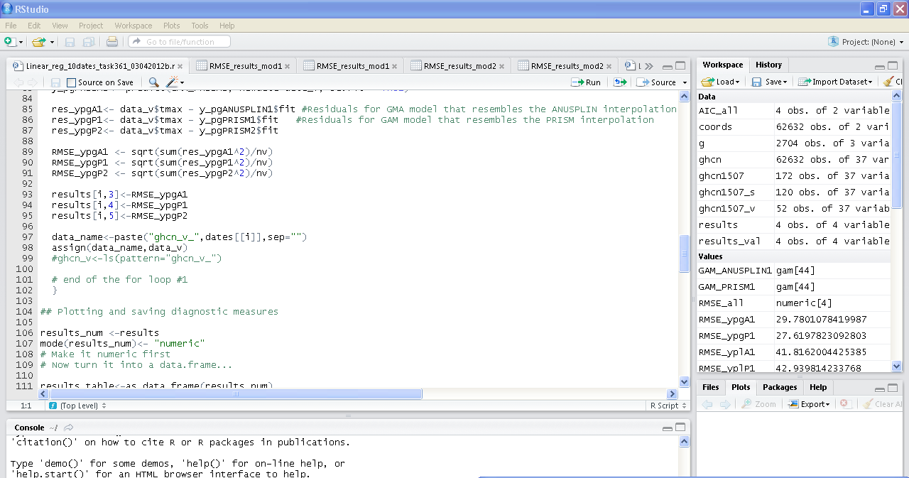
Task 361: GAM interpolation for 10 dates for the Oregon Case study
Script 2: Takes in a list of 10 dates to produce diagnostic measures and plots
Produces plots and RMSE for 10 dates.

Slide 2
Task 361: GAM interpolation for 10 dates for the Oregon Case study
 | dates | ns
1 | 20100118 | 119
2 | 20100119 | 121
3 | 20100320 | 117
4 | 20100321 | 118
5 | 20100515 | 118
6 | 20100516 | 118
7 | 20100715 | 120
8 | 20100716 | 121
9 | 20100920 | 122
10 | 20100921 | 120
 | dates | ns
1 | 20100101 | 115
2 | 20100102 | 116
3 | 20100301 | 122
4 | 20100302 | 123
5 | 20100501 | 115
6 | 20100502 | 115
7 | 20100701 | 124
8 | 20100702 | 121
9 | 20100901 | 120
10 | 20100902 | 121
Year 2010, 10 dates were chosen and a r script was developed to produce prediction based on a set of validation stations.
There are 186 stations in Oregon for the year 2010 with only 49 stations containing data for every day of the year.
365*186=67890

Slide 3
MODEL 1: ANUSPLIN LIKE

Slide 4
MODEL 2: PRISM-LIKE

Slide 5
MODEL 3: PRISM- LIKE

Slide 6
RMSE: ANUSPLIN1 –like model

Slide 7
RMSE: PRISM1
–like model

Slide 8
RMSE: ANUSPLIN1 –like model

Slide 9
AVERAGE RMSE FOR THE THREE MODELS
Run 2 on data
 | dates | ns | RMSE_A1 | RMSE_P1 | RMSE_P2
1 | 20100101 | 115 | 27.42994 | 26.31229 | 27.1614
2 | 20100102 | 116 | 31.45887 | 31.70496 | 29.04014
3 | 20100301 | 122 | 16.97622 | 17.23832 | 16.75766
4 | 20100302 | 123 | 23.28811 | 20.09387 | 20.39007
5 | 20100501 | 115 | 16.69071 | 16.06978 | 16.52471
6 | 20100502 | 115 | 20.45138 | 19.8921 | 21.64925
7 | 20100701 | 124 | 25.84065 | 25.27325 | 26.71122
8 | 20100702 | 121 | 27.16727 | 27.73306 | 28.92403
9 | 20100901 | 120 | 23.88927 | 23.36549 | 22.88697
10 | 20100902 | 121 | 35.38707 | 34.51449 | 34.25004
 |  | avg | 24.85795 | 24.21976 | 24.42955
 |  | median | 24.86496 | 24.31937 | 24.7991
 |  | max | 35.38707 | 34.51449 | 34.25004
 |  | min | 16.69071 | 16.06978 | 16.52471
Average is about 2.42 deg C for the best model P1 on run 2.

Slide 10
RMSE FOR ALL THREE MODELS FOR THE 10 dates.

Slide 11
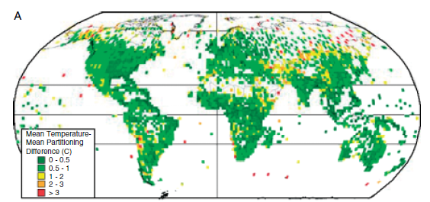
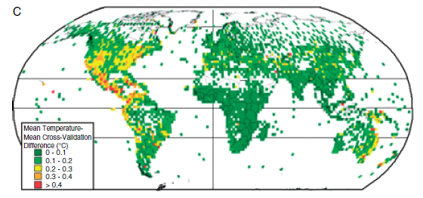
HOW WELL DOES IT COMPARE TO AVERAGE RMSE FROM WORLDCLIM??
0.5 to 1 C difference?
Is this possible?
Note that this is an average over 12 months and 2x2 degree squares…

Slide 12
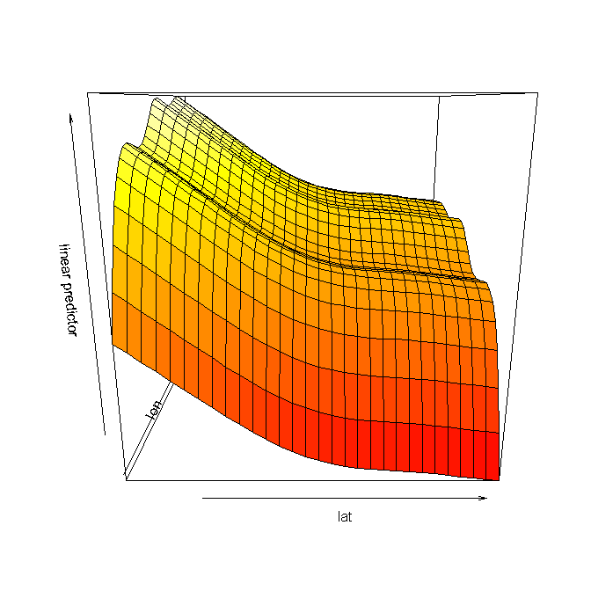
DIAGNOSTIC PLOTS IN THE PIPELINE
20100902
ANUSPLIN-Like GAM

Slide 13
NEXT STEPS: 1. Integrate spatial information: MODIS LST
2. GWR?
3. Visualize the RMSE in the landscape.
4. Comparison with Worldclim for the year 2000.
5. Screening for “bad” observations.

