Slide 1

ENVIRONMENTAL LAYERS
IPLANT MEETING WEBEX
2012-03-20
Roundup 3
Benoit Parmentier

Slide 2
What I have been doing working on:
Using Geographically Weighted regression
Reading on GWR
Writing a code in R using the spgwr package
Prediction: first assessment using RMSE fit and different hold out proportion.
2) Screening data and prediction
Screening data
Some GAM prediction
3) Producing LST mean
Preparing the LST data variable (extraction, projection, clipping)
Calculating mean LST per day and adding variable in the dataset
Writing up a script in python (with IDRISI API but with GDAL in mind)
4) Examining interactions in GAM
Plotting graph to find interaction terms
Some GAM prediction

Slide 3
GAM SCREENING
GAM_ANUSPLIN1:
tmax~ s(lat) + s (lon) + s (ELEV_SRTM))
GAM_PRISM1:
tmax~ s(lat) + s (lon) + s (ELEV_SRTM) + s (Northness)+ s (Eastness) + s(DISTOC))
GAM_PRISM2:
tmax~ s(lat) + s (lon) + s (ELEV_SRTM) + s (Northness_w)+ s (Eastness_w) + s(DISTOC))

Slide 4
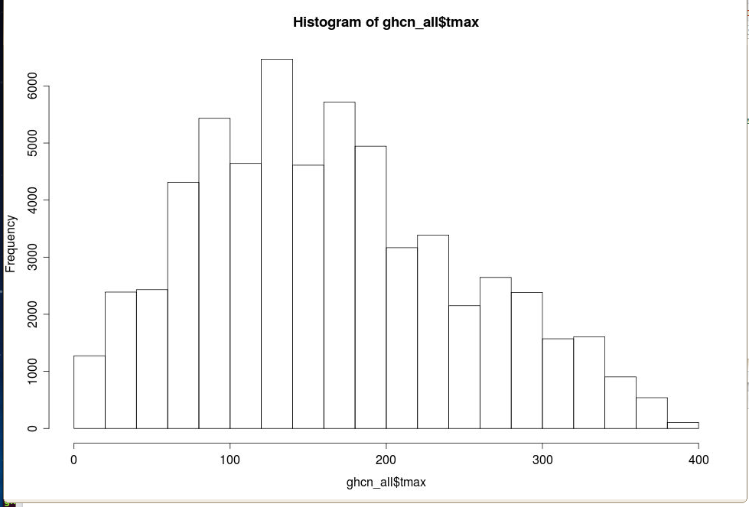
SCREENING THE DATA FOR UNUSUAL DATA VALUES
range(ghcn_all$DISTOC)
[1] 926.59 571860.00
range(ghcn_all$tmax)
[1] -144 422
range(ghcn_all$ELEV_SRTM)
[1] -9999 2122
What is the valid range of temperature in OR ??
Notes:
range(ghcn_all$lon)
[1] -124.5011 -116.9717
range(ghcn_all$lat)
[1] 42.0569 46.1569
range(ghcn_all$Eastness)
[1] -0.9993366 0.9999648

Slide 5
SCREENING THE DATA FOR UNUSUAL DATA VALUES
 |  | screened | not screened
 | dates | ns | ns | loss ns
1 | 20100101 | 109 | 115 | -6
2 | 20100102 | 113 | 116 | -3
3 | 20100301 | 120 | 122 | -2
4 | 20100302 | 121 | 123 | -2
5 | 20100501 | 113 | 115 | -2
6 | 20100502 | 114 | 115 | -1
7 | 20100701 | 123 | 124 | -1
8 | 20100702 | 120 | 121 | -1
9 | 20100901 | 119 | 120 | -1
10 | 20100902 | 120 | 121 | -1
Range of values:
0<tmax<400)
ELEV_SRTM>0
365X172=62,780 stations maximum for the year 2010.
ghcn_all : 62632 observations
Ghcn_test: 61299 observations (tmax screened)
Ghcn_test2: 60668 observations
There were 62001 observations with elevation greater than 0m i.e. 631 below zero meters.

Slide 6
RMSE FOR ALL THREE MODELS FOR THE 10 dates.
RMSE without screening of data values.

Slide 7
RMSE FOR ALL THREE MODELS FOR THE 10 dates after screening

Slide 8
AVERAGE AND MEDIAN RMSE
FOR ALL THREE MODELS FOR THE 10 dates.
For the 10 dates, we note that the number of loss of stations is very small but the impact on the RMSE is important.

Slide 9
GEOGRAPHICALLY WEIGTHED REGRESSION

Slide 10
GEOGRAPHICALLY WEIGTHED REGRESSION
GWR predictions were produced using the sgwr package in R.
The following specifications were used to run the models:
Dependent variable: tmax
Independent variables: lon, lat, ELEV_SRTM, Eastness, Northness, DISTOC
Bandwidth: determined from the data by CV (one leave out approach).
Weight function model: Gaussian
proportion of hold out: 0 %, 30%, 50%, 70%
validation: RMSE fit

Slide 11
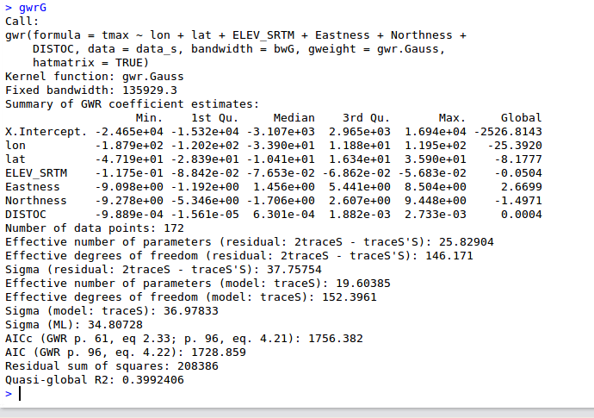
INTERPOLATION WITH GEOGRAPHICALLY WEIGHTED REGRESSION
For the last date: 20100902
No Hold-out: Proportion: 0
Code: gwr_Oregon_03132012c.R

Slide 12
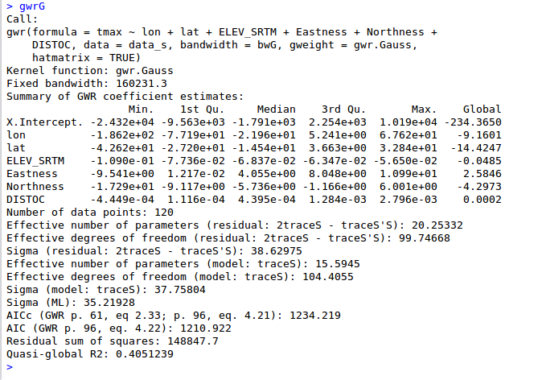
INTERPOLATION WITH GEOGRAPHICALLY WEIGHTED REGRESSION
No Hold-out: Proportion: 30%
For the last date: 20100902

Slide 13
RMSE FIT FOR GWR FOR DIFFERENT % HOLD-OUT AND DATES
Note that the data was screened…

Slide 14
It is somewhat surprising that the lowest RMSE is obtained for the largest hold out (of 70%).
It may be necessary to redo the prediction with the same proportion but by changing the sample!

Slide 15
RMSE COMPARISON: GWR AND GAM MODELS FOR THE TEN DATES
Note that the RMSE is a fit for GWR and validation for GAM!!
When data are not screened the GWR model performs poorly (purple spike).
Notes:
Gwr1_30: this model does not have screening and use a proportion of 0.3 for the hold out.

Slide 16
RMSE COMPARISON: GWR AND GAM MODELS FOR THE TEN DATES
GWR models
The median and average RMSE is greater for GWR!

Slide 17
VALIDATION APPROACHES
Approach 1
First GWR is performed on the training dataset to produce coefficients at every training stations.
Second a surface of parameters (slope coefficient) is obtained by interpolation (Kriging).
Third, tmax values at testing samples are then obtained by applying the parameters at the testing locations.
Fourth an RMSE is calculated for the testing dataset.
2) Approach 2
First, GWR is performed on the training dataset and the bandwidth is obtained.
Second, the training bandwidth is then used when running GWR on the testing dataset.
Third, coefficients produced at testing sites are used to predict tmax values for testing samples.
Fourth an RMSE is calculated for the testing dataset.

Slide 18
VALIDATION REFERENCES
Harris P., A.S. Fotheringham, R. Crespo, M. Charlton. (2010). The Use of Geographically Weighted Regression for Spatial Prediction: An Evaluation of Models Using Simulated Data Sets. Math Geosci:: 657–680
Llyod C.D. (2010). Nonstationary models for exploring and mapping monthly precipitation in the United Kingdom. INTERNATIONAL JOURNAL OF CLIMATOLOGY Int. J. Climatol. 30: 390–405.
Wimberly1 M.C., M. J. Yabsley, A. D. Baer1, V. G. Dugan, and W. R. Davidson (2008). Spatial heterogeneity of climate and land-cover constraints on distributions of tick-borne pathogens land-cover constraints on distributions of tick-borne pathogens Global Ecology and Biogeography, (Global Ecol. Biogeogr.) 17, 189–202.

Slide 19
LAND SURFACE TEMPERATURE
PROCESSING

Slide 20
PYTHON SCRIPT
Check input and missing files…
Extract from hdf (idrisi/gdal)
Mosaic (idrisi/gdal)
Project (idrisi/gdal)
GROUP files per
- year
-day
-per month
Calculate average per day (IDRISI-GRASS/R-RASTER or GDAL)
Calculate average per month (IDRISI-GRASS/R-RASTER or GDAL)
→ Missing dates ordered on NASA REVERB…

Slide 21
An example of the average for day 244 (Sept 1)
Average for day 244 over 2001-2010: the LST values need to be rescaled (multiplication factor is 0.02).

Slide 22
TAKING INTO ACCOUNT THE QUALITY FLAGS
Oregon_2008_366_MOD11A1_Reprojected_QC_Day.rst

Slide 23
TAKING INTO ACCOUNT THE QUALITY FLAGS
Oregon_2008_366_MOD11A1_Reprojected_LST_Day_1km.rst

Slide 24
TAKING INTO ACCOUNT THE QUALITY FLAGS

