Slide 1

ENVIRONMENTAL LAYERS MEETING
IPLANT TUCSON
2012-05-01
Roundup
Benoit Parmentier

Slide 2
What I have been working on:
1) GAM prediction for 365 dates and first round up of results
Assessing results across the year.
2) GAM prediction: model diagnostics and residuals
Contribution of variables
Outliers: searching for patterns.
Improving screening of unreliable observations.
Land cover and LST
3) Examining the effect of sampling on the results
Examining the RMSE for different training and testing samples
Examining the RMSE for the different hold out proportions.
4) Incorporating spatial information: Kriging and spatial filtering
GAM + Kriging
Spatial eigenvectors

Slide 3
1) ASSESSING RESULTS ACROSS THE YEAR:
Running GAM over 365 dates

Slide 4
GAM MODELS USED FOR THE ANALYSIS
Using monthly LST mean…
mod1<- tmax~ s(lat) + s (lon) + s (ELEV_SRTM)
mod2<- tmax~ s(lat,lon) +s(ELEV_SRTM)
mod3<- tmax~ s(lat) + s (lon) + s (ELEV_SRTM) + s (Northness)+ s (Eastness) + s(DISTOC)
mod4<- tmax~ s(lat) + s (lon) + s(ELEV_SRTM) + s(Northness) + s (Eastness) + s(DISTOC) + s(LST)
mod5<- tmax~ s(lat,lon) +s(ELEV_SRTM) + s(Northness,Eastness) + s(DISTOC) + s(LST)
mod6<- tmax~ s(lat,lon) +s(ELEV_SRTM) + s(Northness,Eastness) + s(DISTOC) + s(LST,LC1)
mod7<- tmax~ s(lat,lon) +s(ELEV_SRTM) + s(Northness,Eastness) + s(DISTOC) + s(LST,LC3)
mod8<- tmax~ s(lat,lon) +s(ELEV_SRTM) + s(Northness,Eastness) + s(DISTOC) + s(LST) + s(LC1)

Slide 5
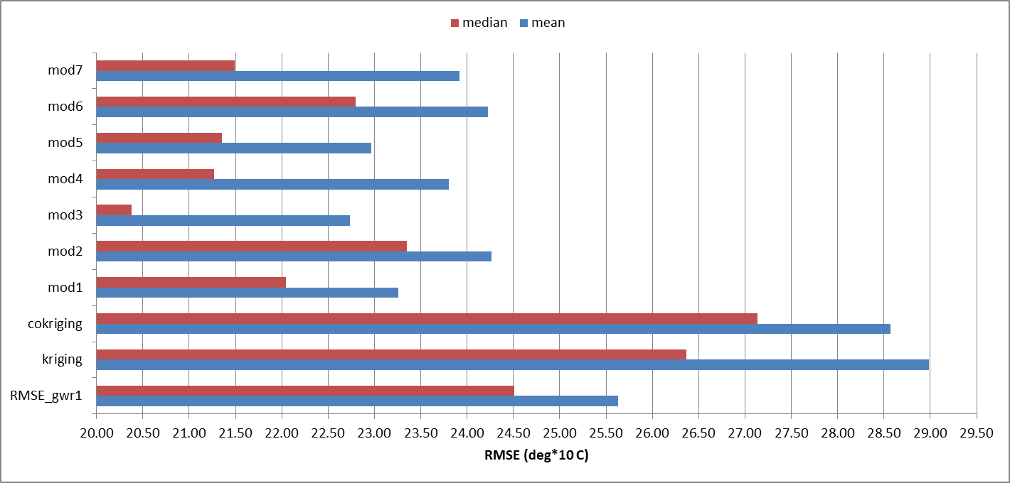
FIRST SUMMARY ROUND UP
Mean and median RMSE based on the 10 selected dates.
mod3<- tmax~ s(lat) + s (lon) + s (ELEV_SRTM) + s (Northness)+ s (Eastness) + s(DISTOC)

Slide 6
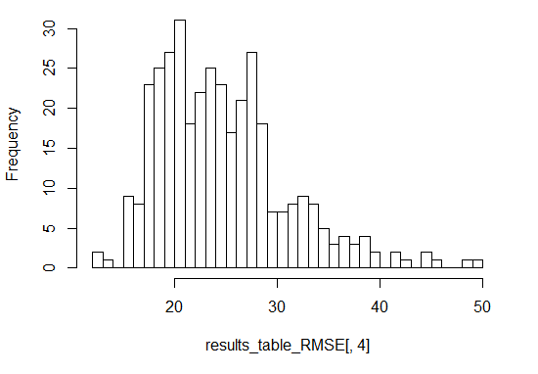
RMSE DISTRIBUTION FOR YEAR 2010
mod2<- tmax~ s(lat,lon) +s(ELEV_SRTM)

Slide 7
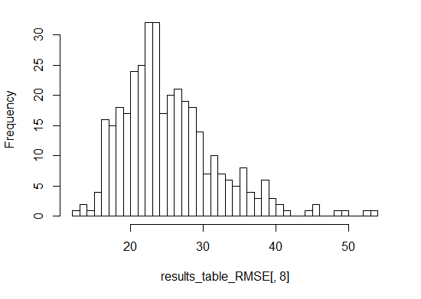
RMSE DISTRIBUTION FOR YEAR 2010
Working on 365 dates…
mod6<- tmax~ s(lat,lon) +s(ELEV_SRTM) + s(Northness,Eastness) + s(DISTOC) + s(LST,LC1)

Slide 8
ASSESSING RESULTS ACROSS THE YEAR:
Running GAM over 365 dates
→ Mean RMSE is between 2.4C and 2.5C with model 2 performing the best but…:
- The data suggest that models with LST might perform better when some winter dates are removed.
- thus we must assess the RMSE per month/seasons and different hold out.

Slide 9
2) GAM prediction: model diagnostics and residuals
Contribution of variables
Outliers: searching for patterns.
Improving screening of unreliable observations.
Land cover and LST

Slide 10
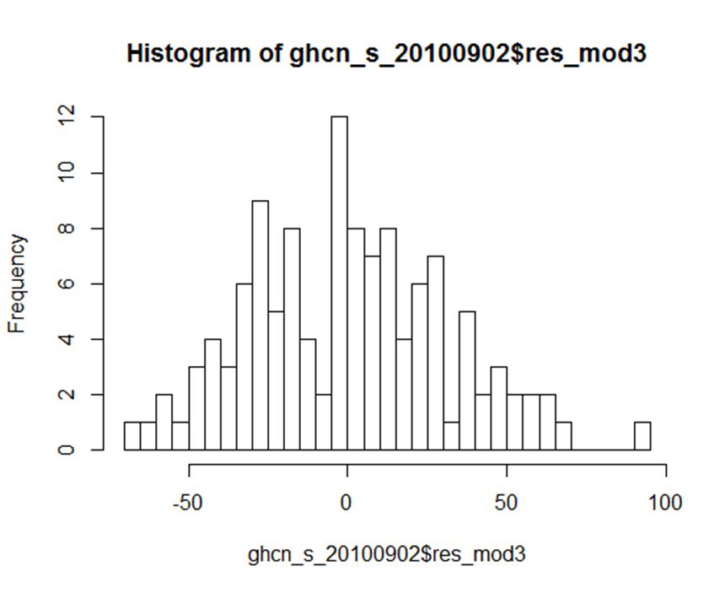
HIGHEST RMSE FOR DATE 09022012
RESIDUALS FOR MODEL 3
mod3<- tmax~ s(lat) + s (lon) + s (ELEV_SRTM) + s (Northness)+ s (Eastness) + s(DISTOC)

Slide 11
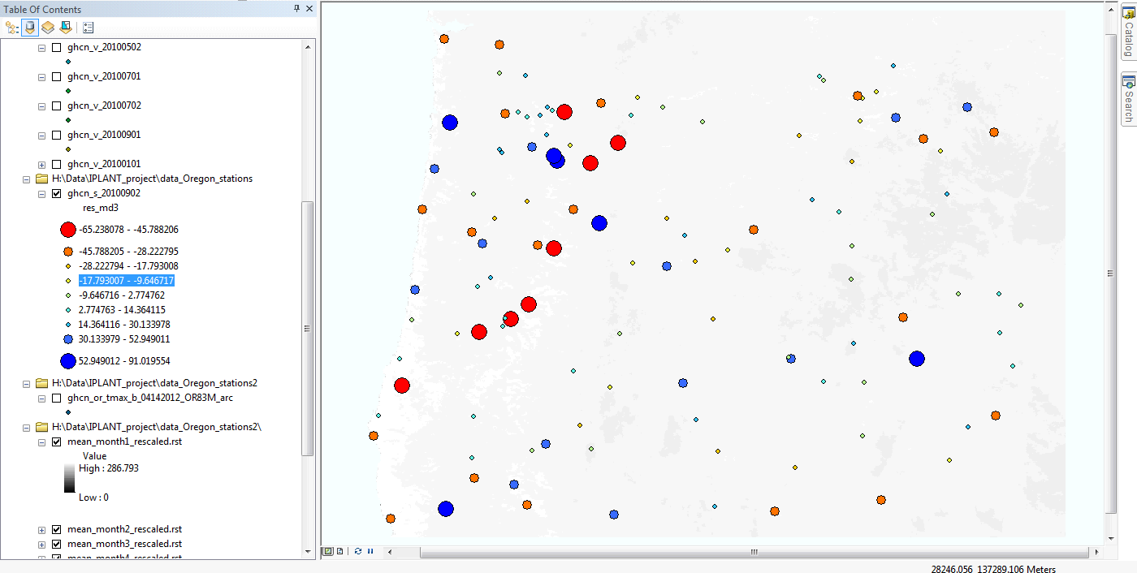
GHCN_S_20100902
91

Slide 12
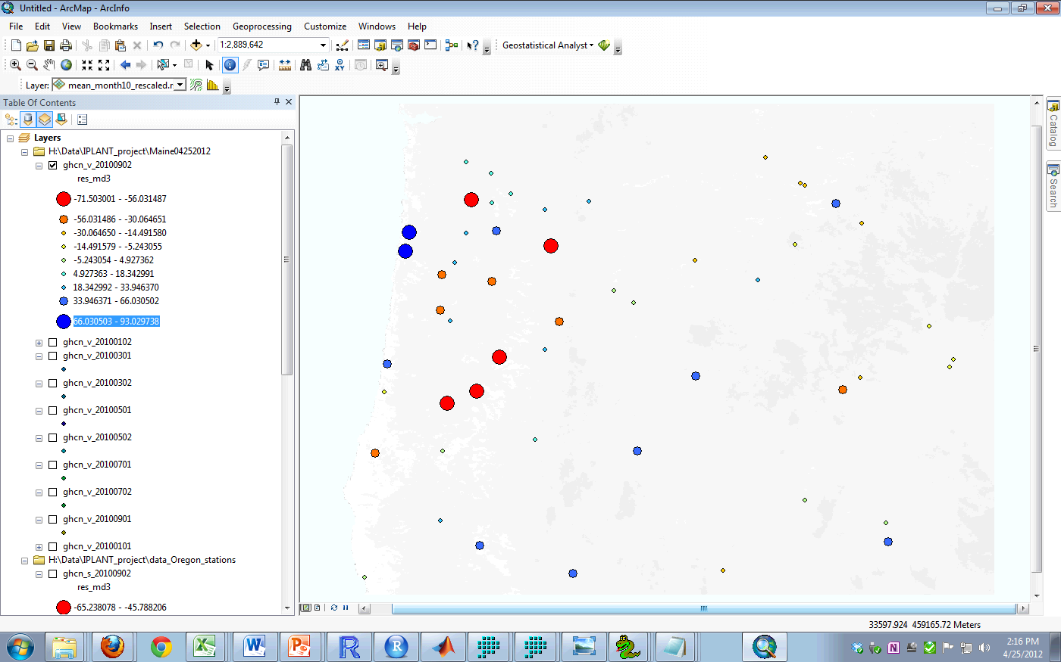
GHCN_V_20100902
93

Slide 13
3) ASSESSING THE STABILITY OF THE RESULTS:
INFLUENCE OF SAMPLING

Slide 14
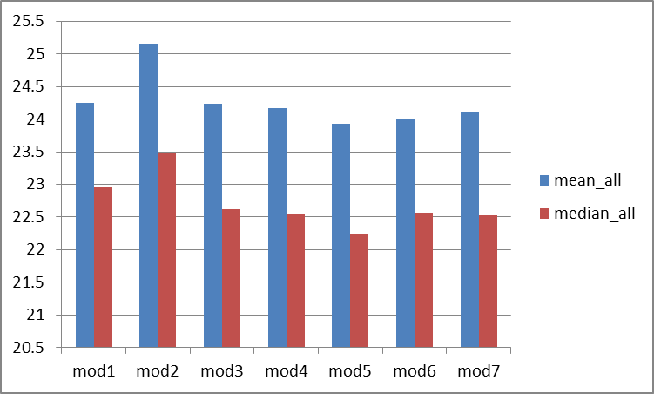
SUMMARY STATISTICS FOR DIFFERENT SAMPLING
Median and Averages were calculated for 260 runs (26x10dates).
The first results indicate that models with the inclusion of LST have lowest median RMSE.
mod5<- tmax~ s(lat,lon) +s(ELEV_SRTM) + s(Northness,Eastness) + s(DISTOC) + s(LST)

Slide 15
Continue working on:
1) GAM prediction for 365 dates
Assessing results across the year:
→ per month and seasons
2) GAM prediction: model diagnostics and residuals
Contribution of variables
Outliers: searching for patterns.
Improving screening of unreliable observations.
Land cover and LST
3) Examining the effect of sampling on the results
Examining the RMSE for different training and testing samples
Examining the RMSE for the different hold out proportions.
Examining for
4) Incorporating spatial information: Kriging and spatial filtering
GAM + Kriging
Spatial eigenvectors

