Slide 1
Remotely sensed land cover heterogeneity
Mao-Ning Tuanmu
5/29/2012

Slide 2
Outline
Objectives & rationale
Remotely sensed data
Heterogeneity metrics
Calculation approaches of heterogeneity metrics
Next steps

Slide 3
Spatial heterogeneity of land cover
Species distributions and biodiversity patterns
Landscape metrics based on categorical land cover maps
Boundary delineation
Heterogeneity within a land cover type
Continuous measures of land surface characteristics from remote sensing

Slide 4
Objectives
To explore different approaches for quantifying land cover heterogeneity based on remotely sensed data
To generate remote sensing-based heterogeneity metrics at the global scale
To evaluate the usefulness of those metrics for explaining biodiversity patterns and monitoring their temporal dynamics

Slide 5
Remote Sensing Imagery
Landsat 5 TM and Landsat 7 ETM+
Global Land Survey (GLS) surface reflectance
7 bands, QA
Three epochs: 1990, 2000, 2005
7,000~8,000+ scenes for each epoch
22 scenes covering the entire Oregon
Vegetation indices
NDVI

Slide 6
Remote Sensing-Based Metrics
First-order texture measures
Statistics calculated from image pixel values
Composition of pixel values
Average, SD, range, maximum, minimum and etc. of pixel values within a pixel neighborhood
Values of individual spectral bands
Linear or non-linear combinations of spectral bands

Slide 7
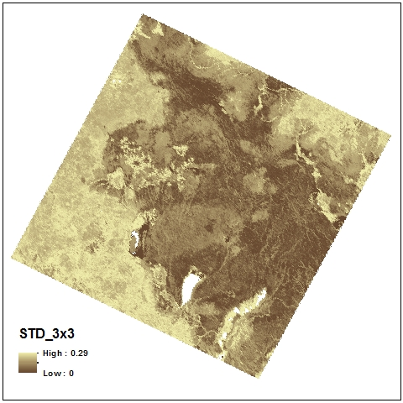
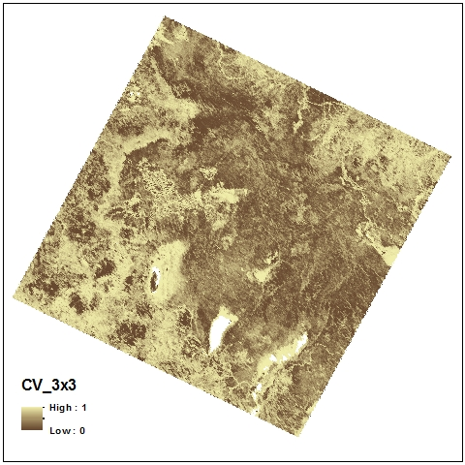
First-order Texture Measures
Standard deviation
Coefficient of variation

Slide 8
Remote Sensing-Based Metrics
Second-order texture measures
Statistics calculated based on values of pixel pairs
Information on the spatial relationship between two pixels
Spatial configuration (or arrangement) of pixel values
Metrics based on the Gray Level Co-occurrence Matrix (GLCM)

Slide 9
Gray Level Co-occurrence Matrix (GLCM)
A tabulation of how often different combinations of pixel brightness values (grey levels) occur in a pixel neighborhood
A symmetric n-by-n matrix, where n is the number of all possible gray levels (e.g., n=16 (2^4) for a 4-bit image)
The element Pij of a GLCM is the occurrence probability of the pixel pairs with values i and j within a pixel neighborhood

Slide 10
GLCM Metrics
Pixel neighborhood
Pixel pairs
Direction (0°, 90°, 45°, 135°)
Offset distance (offset = 0)
Metrics
Contrast-related
Contrast, dissimilarity, homogeneity
Orderliness-related
Angular second moment, entropy
Descriptive statistics
Mean, variance, correlation
a | b | c
d | e | f
g | h | i

Slide 11
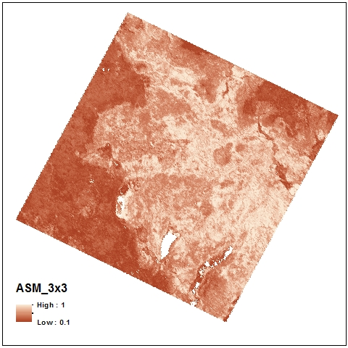
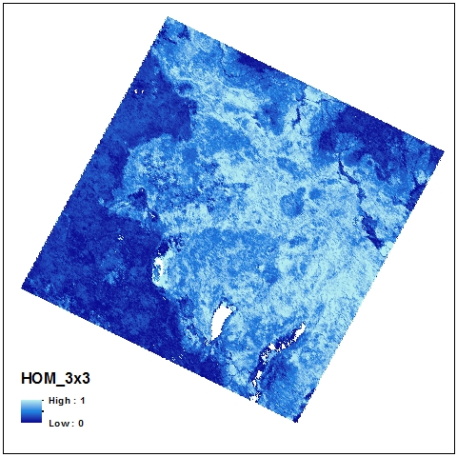
Second-order Texture Measures
Angular second moment
$$\sum_{i,j=0}^{N−1}{{P_{ij}}^{2}}$$
Homogeneity
$$\sum_{i,j=0}^{N−1}{{P_{ij}}/{1+{(i−j)}^{2}}}$$

Slide 12
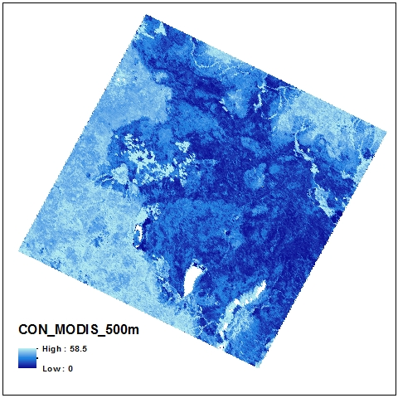
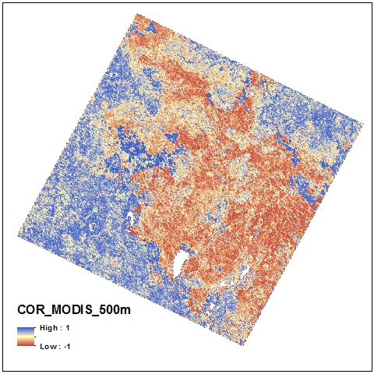
Second-order Texture Measures
Contrast
$$\sum_{i,j=0}^{N−1}{P_{ij}{(i−j)}^{2}}$$
Correlation
$$\sum_{i,j=0}^{N−1}{P_{ij}\left[{\left(i−μ_{i}\right)\left(j−μ_{j}\right)}/{\sqrt{\left(σ_{i}^{2}\right)\left(σ_{j}^{2}\right)}}\right]}$$

Slide 13
Moving Window vs. Fixed Grid
Moving window approach
Run a moving window across the entire image (study area) to calculate first- and second-order metrics for each pixel (e.g., Landsat pixel of 30m)
Aggregate metric values (e.g., calculate mean and SD) for a larger regular grid (e.g., MODIS 500m grid) or specific area (e.g., sampling plot)
Fixed grid approach
Directly calculate metrics based on the values of Landsat pixels within each MODIS pixel

Slide 14
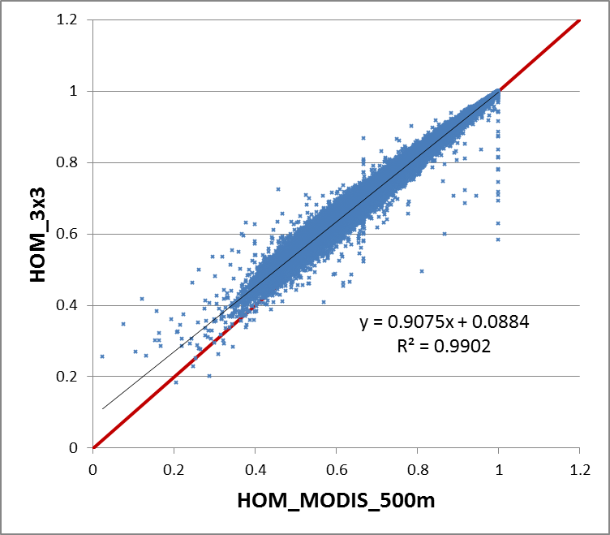
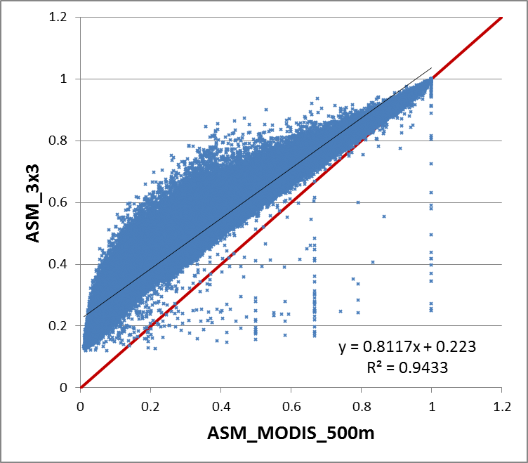
Approach Comparison
Homogeneity
Angular second moment
Moving window approach
(Mean of metric values in 3x3 windows)
Fixed grid approach
(Metric values in MODIS 500m grids)

Slide 15
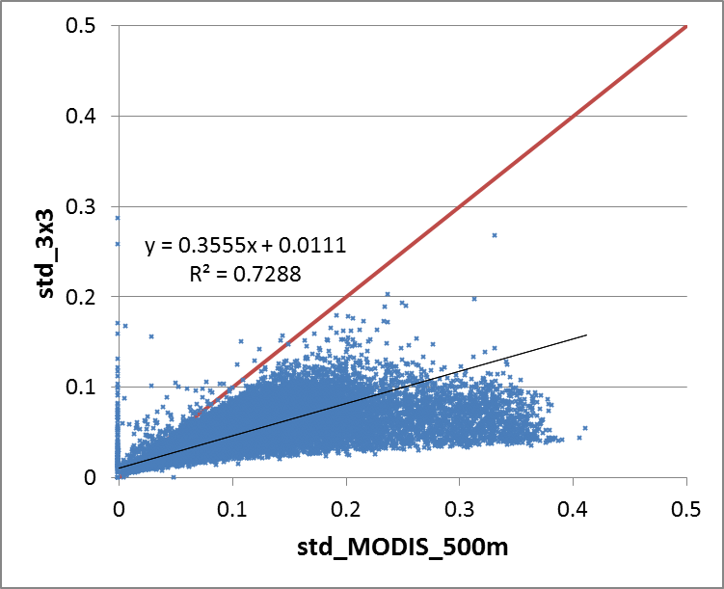
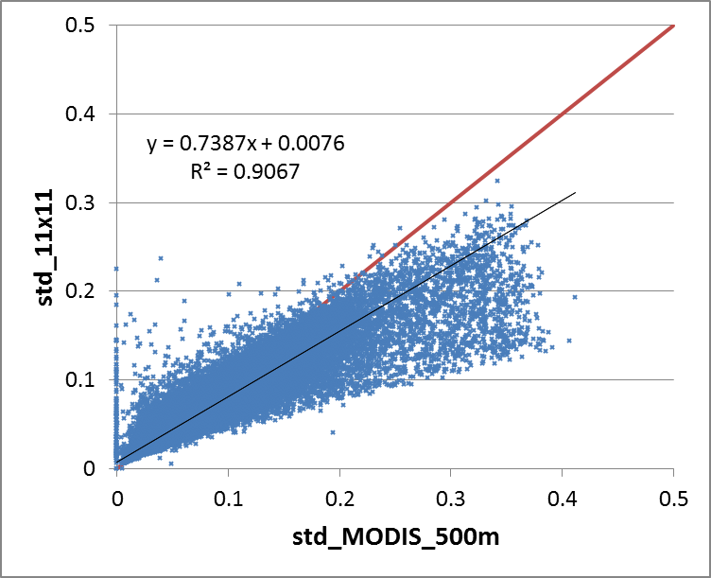
Approach Comparison
Standard Deviation
3x3 moving window
11x11 moving window
Moving window approach
(Mean of metric values in moving windows)
Fixed grid approach
(Metric values in MODIS 500m grids)

Slide 16
Moving Window vs. Fixed Grid
Moving window approach
Texture characteristics at different grains (3x3, 11x11…)
Computation-intensive
Fixed grid approach
Texture characteristics at the scale of the fixed grid
Easier to interpret
Much less computation-intensive (> 10 times faster)

Slide 17
Next Steps
Comparison between texture measures and landscape metrics from categorical land cover data (NLCD)
Fragstats
Only in the Windows system
Cannot handle the entire Landsat scene with the moving window approach

Slide 18
Next Steps
Metrics related to spatial autocorrelation
Measures of spatial autocorrelation (e.g., Moran’s I)
Characteristics of variogram (e.g., sill and range)
Seasonality effects
Cropland
Mosaicked images from NASA

