Slide 1
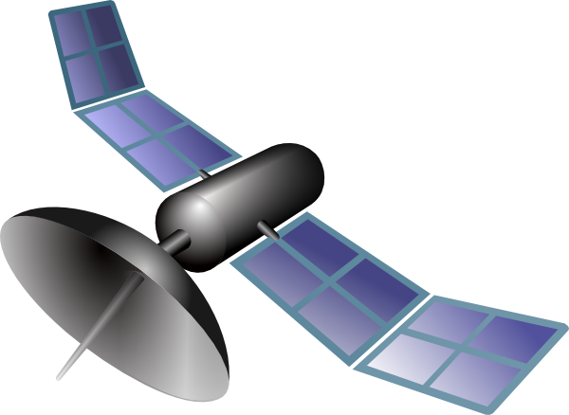
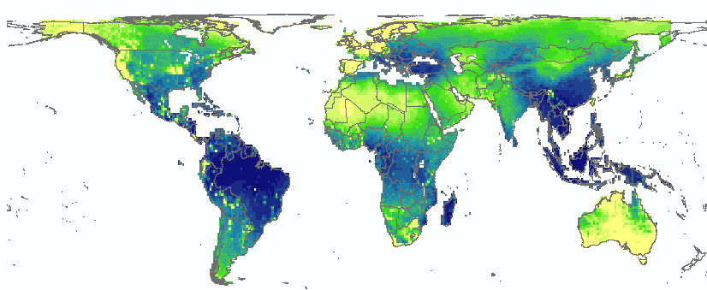
Remotely observed functional diversity
NSC
…
N
T₂
LMA
FD
Global
Biodiversity Observatory
NSC
…
N
T₁
LMA
FD
Integrated
in situ biodiversity observations
Phylogenetics
Plant trait data
Species
distribution
data

