Slide 1
Species with trait data
All species
S
N
Figure 1: Latitudinal variation in the richness of all vascular plant species (black; after Kreft & Jetz 2007) and those with mobilized trait data (white; from TRY, Jun 2015) among 110km grid cells (N = 11,626).

Slide 2
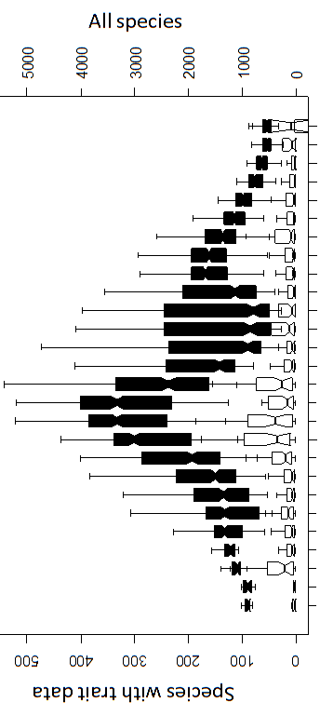



(May be prettier to move latitude plot to right side; designer could apply same gradient colors as on map to black bars [Y axis])
All
Traits
Richness
10
100
1,000
2,000
5,000
Figure 1: Geographic and latitudinal variation in the richness of all vascular plant species (black; after Kreft & Jetz 2007) and those with mobilized trait data (white; from TRY, Jun 2015) among 110km grid cells (N = 11,626).

