Slide 1

ENVIRONMENTAL LAYERS MEETING
IPLANT TUCSON
2012-07-10
Roundup
Benoit Parmentier

Slide 2
FUSION METHOD: EARLY RESULTS
July 10, 2012

Slide 3
Climatology Aided Interpolation through fusion
Strategy: divide the variability in a long term component and a daily component.
→ Similar to Willmott and Robeson 1995 and Haylock et al. 2008 but using additional steps and LST bias surface.
Harder to predict with static covariates: auto-interpolation seems appropriate
Tmax:
Daily value
Variability may be due to daily weather phenomena (air masses and front, local convection)
DELTA
TMax:
Monthly normal/avg
BIAS
Variability may be due to diff between skin and air temp.
This is the long term component of tmax.
LST Monthly
Normal/avg
May plug in modeling of surface through elevation and other covariates that are static??
LST
0 C
Tmax(daily)=LST(month)+LST_bias(month)+tmax_delta(daily)

Slide 4
FUSION METHODS: Brian McGill
Monthly tmax
- Derive monthly mean at every station based on a reference time period for every month.
Day LST averages and BIAS
Calculate monthly averages from daily MOD11A1
Difference between monthly LST averages and monthly Tmax at stations: this is the “bias”.
Produce a bias surface at every location using: Kriging, TPS or GAM.
Daily deviation: delta
Difference between daily values and monthly Tmax at stations: this is the “delta”.
Produce a delta surface at every location using: Kriging, TPS or GAM.
Two current code versions:
fusion_analysis_07052012_GAM_Fusion.R : fusion (with Kriging) compared to GAM
fusion_analysis_07052012.R: fusion (with Kriging and GAM) compared fusion (with Kriging)

Slide 5
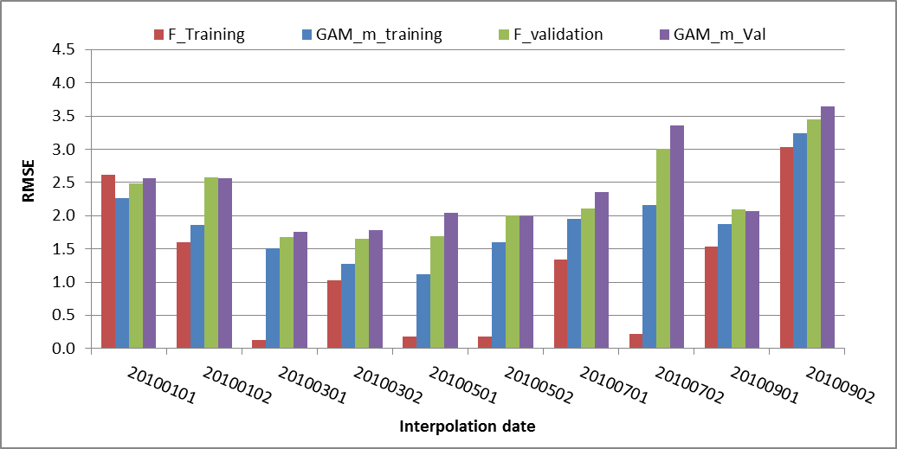
COMPARING FUSION AND GAM
RMSE values for 10 dates in Oregon:
GAM was performed with 7 models using the same validation and training sets as in fusion.
F_training: RMSE fusion with training data
F_validation: RMSE fusion with testing data
GAM_m_val: RMSE for GAM validation
GAM_m_training: RMSE for GAM training
Slopes and aspects were modified!!!

Slide 6
GAM MODELING USED IN THE BIAS
Modeling the LST BIAS using GAM models with environmental covariates.
data_s$y_var<-data_s$LSTD_bias
#data_s$y_var<-(data_s$dailyTmax)*10
#Model and response variable can be changed without affecting the script
mod1<- gam(y_var~ s(lat) + s (lon) + s (ELEV_SRTM), data=data_s)
mod2<- gam(y_var~ s(lat,lon)+ s(ELEV_SRTM), data=data_s) #modified nesting....from 3 to 2
mod3<- gam(y_var~ s(lat) + s (lon) + s (ELEV_SRTM) + s (Northness)+ s (Eastness) + s(DISTOC), data=data_s)
mod4<- gam(y_var~ s(lat) + s (lon) + s(ELEV_SRTM) + s(Northness) + s (Eastness) + s(DISTOC) + s(LST), data=data_s)
mod5<- gam(y_var~ s(lat,lon) +s(ELEV_SRTM) + s(Northness,Eastness) + s(DISTOC) + s(LST), data=data_s)
mod6<- gam(y_var~ s(lat,lon) +s(ELEV_SRTM) + s(Northness,Eastness) + s(DISTOC) + s(LST)+s(LC1), data=data_s)
mod7<- gam(y_var~ s(lat,lon) +s(ELEV_SRTM) + s(Northness,Eastness) + s(DISTOC) + s(LST)+s(LC3), data=data_s)
mod8<- gam(y_var~ s(lat,lon) +s(ELEV_SRTM) + s(Northness,Eastness) + s(DISTOC) + s(LST) + s(LC1), data=data_s)
#Added
→Note that model 6 and 8 are the same. Models were modified to resolve issues related to the insufficient number of observations to calculate GAM parameters.

Slide 7
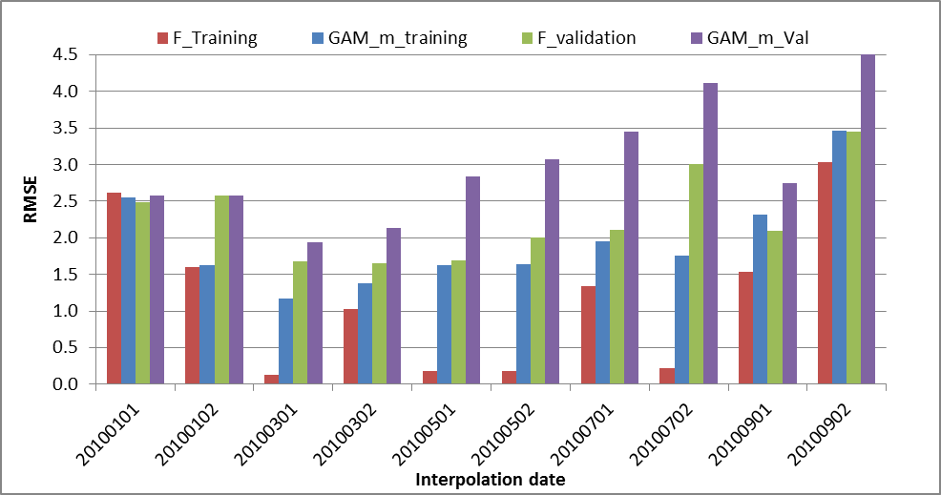
COMPARING FUSION+KRIGING AND FUSION+GAM
RMSE values for 10 dates in Oregon:
GAM was performed with 7 models using the same validation and training sets as in fusion.
F_training: RMSE fusion with training data
F_validation: RMSE fusion with testing data
GAM_m_val: RMSE for fusion using GAM for the bias surface.
GAM_m_training: RMSE for fusion using GAM for the bias surface.

Slide 8
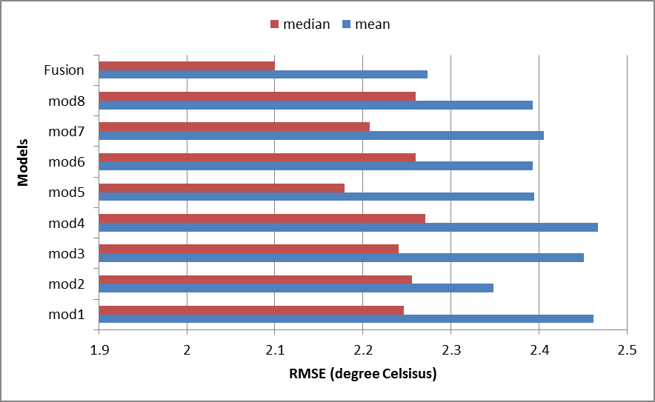
COMPARING FUSION AND GAM
This plot displays the mean and median RMSE across 10 dates in Oregon for 9 models.
GAM: Model 1 through model 8
Model 9= Fusion (using kriging for LST bias and delta tmax)

Slide 9
USC00357857
STATIONS UPDATED FROM THE POSTGRES DATABASE
Codes were updated to allow the use of the new POSTGRES database…
USC00357857
mean_month10_rescaled.rst

Slide 10
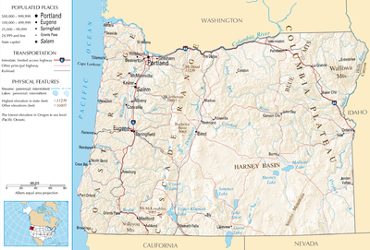
OREGON STATE
http://www.nationalatlas.gov/printable/images/pdf/reference/pagegen_or.pdf

Slide 11
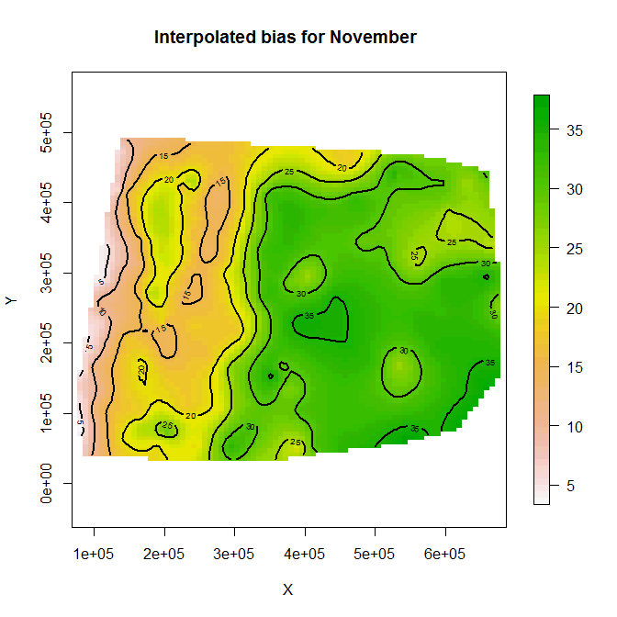
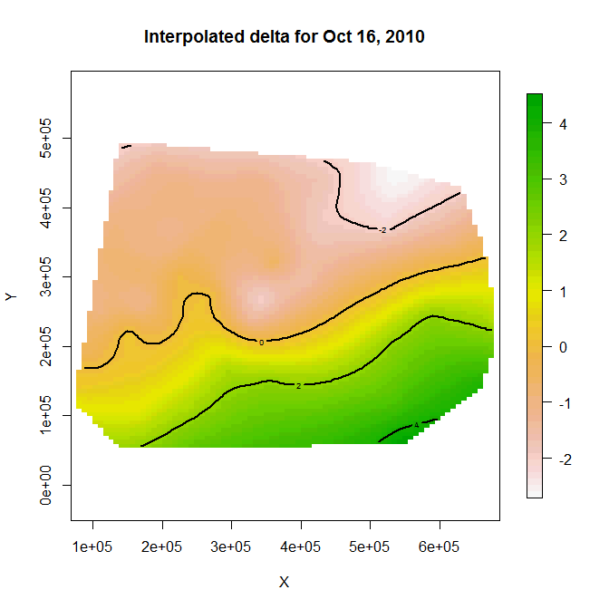
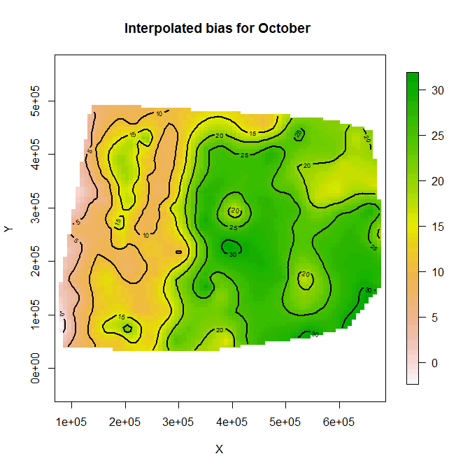
RESULTS USING …
Bias surface for the month of October using kriging from the Field package.

Slide 12
RESULTS USING …
Delta surface for October 16 using kriging from the Field package.
M:\Data\IPLANT_project\data_Oregon_stations\Delta_surface_LST_TMax_20101016_07022012_10d_fusion14.png
Air mass?

Slide 13
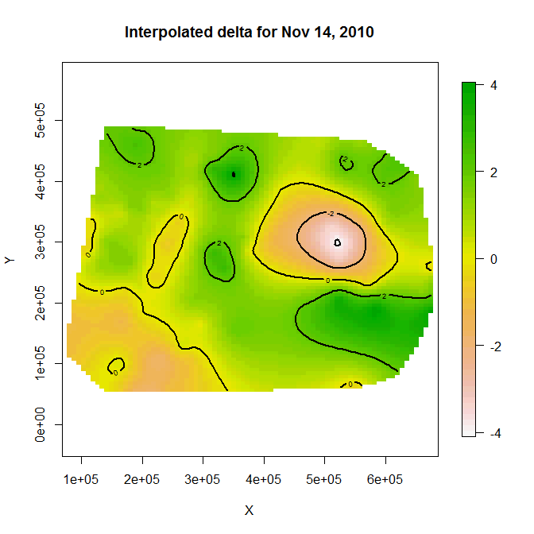
Large variation in delta surface??
RESULTS USING …
Delta surface for October 16 using kriging from the Field package.

Slide 14
Monthly average value per station…
There are 193 stations with monthly Tmax averages in Oregon.
LST AVERAGE FOR THE REGION SURROUNDING PORTLAND
Calculated from 2000 to 2010 for Oregon stations

Slide 15
LST BIAS FOR JANUARY
There are 193 unique stations
The mean bias is: -3.5C for January

Slide 16
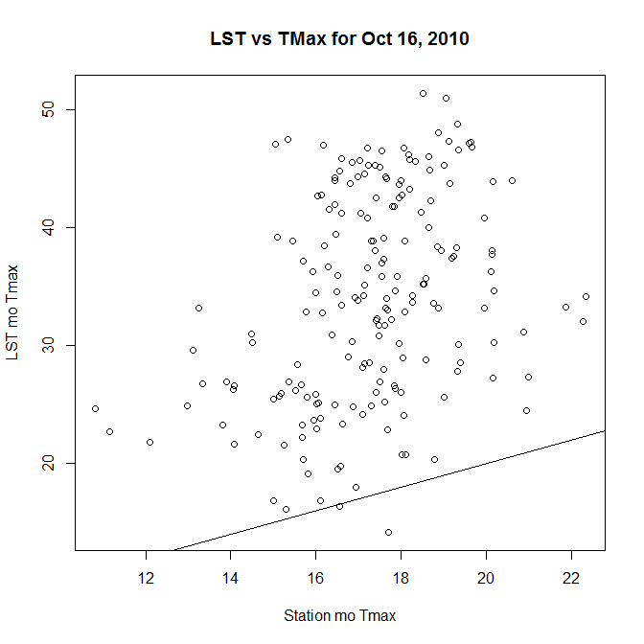

Slide 17
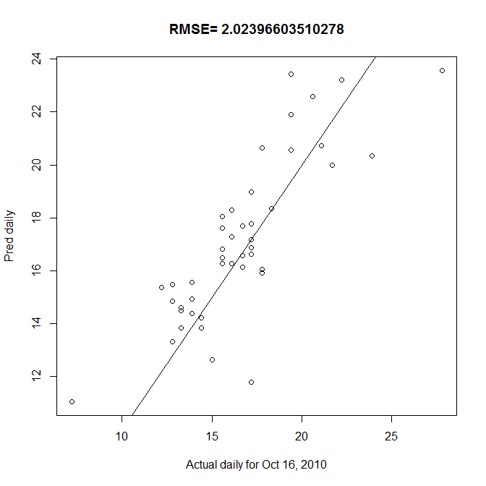

Slide 18
COMPARISON BETWEEN FUSION AND GAM FOR THE YEAR 2010
This is an average over almost a full year (361 days).
This is an average over almost a full year (361 days).
 | mod1 | mod2 | mod3 | mod4 | mod5 | mod6 | mod7 | mod8 | mod9
mean | 2.544616 | 2.475407 | 2.542356 | 2.565878 | 2.528446 | 2.539166 | 2.583812 | 2.539166 | 2.262404
sd | 0.661578 | 0.673336 | 0.68827 | 0.698692 | 0.710643 | 0.696784 | 0.754592 | 0.696784 | 0.67654
gain | 0.258132 | 0.188922 | 0.255872 | 0.279393 | 0.241962 | 0.252682 | 0.297328 | 0.252682 | -0.02408
CI | 0.068476 | 0.069693 | 0.071239 | 0.072317 | 0.073554 | 0.07212 | 0.078103 | 0.07212 | 0.070025

Slide 19
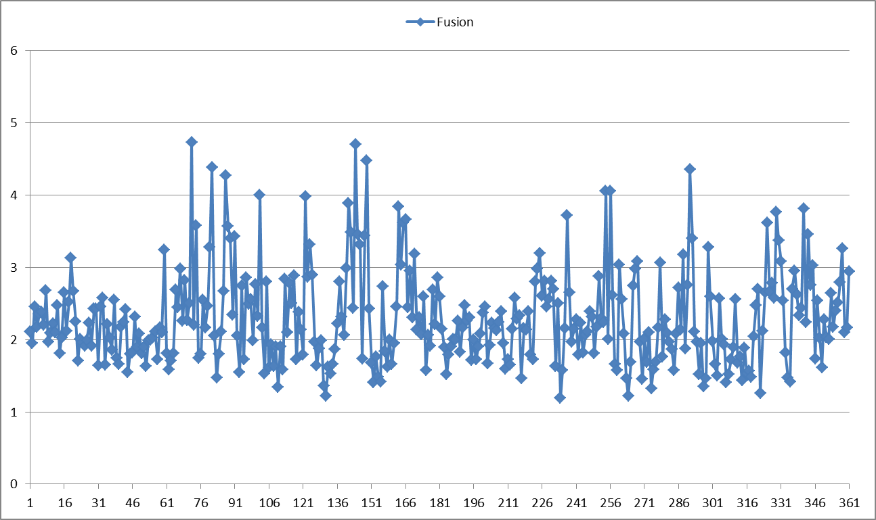
RMSE TIME SERIES FOR FUSION MODEL
July 1

Slide 20
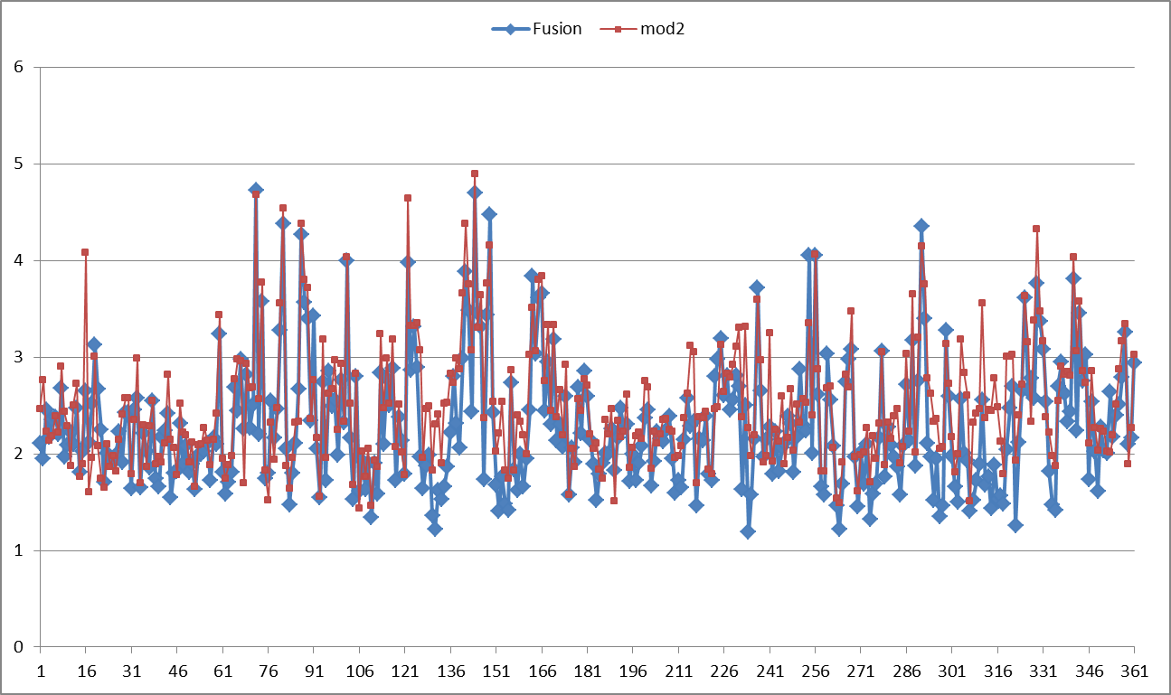
RMSE TIME SERIES FOR FUSION MODEL
Mod2 is the model that is ranked number 2.

Slide 21
DELTA SURFACE SEQUENCE…

Slide 22
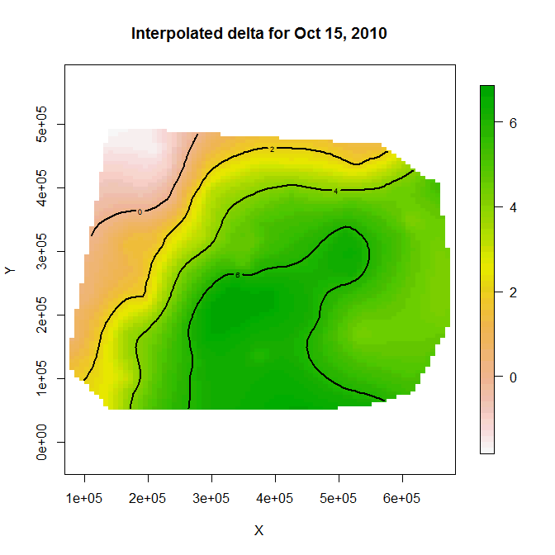

Slide 23
RESULTS USING …
M:\Data\IPLANT_project\data_Oregon_stations\Delta_surface_LST_TMax_20101017_07022012_10d_fusion14.png
Air mass?

Slide 24
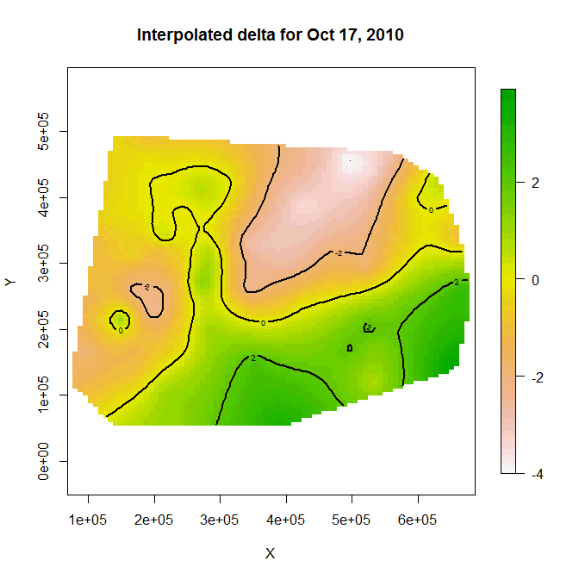

Slide 25
Using training only

Slide 26
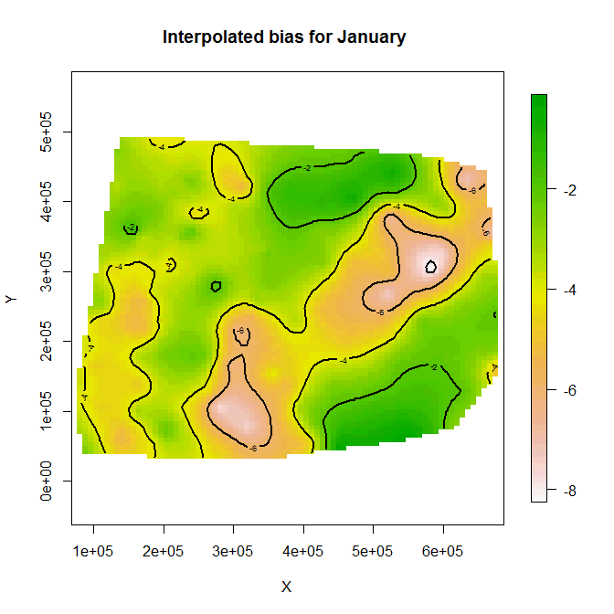
All…

